Slide 1

Project Title -
Seasonal Agriculture Performance Analysis
Student Name- AYUSH SHARMA
College Name- TECHNOCRATS INSTITUTE OF TECHNOLOGY, BHOPAL
AICTE STU ID : STU6a66c0a22a3af1785118882

Slide 2

PROBLEM STATEMENT :-
Agricultural activities are influenced by seasonal variations in environmental conditions, farming practices, resource availability and market conditions. As a result, agricultural performance may differ from one season to another. However, raw agricultural data does not clearly explain how agricultural performance changes across seasons or what patterns can be observed in different seasonal conditions. The problem is to analyze the given agricultural dataset and investigate seasonal differences in agricultural performance by identifying meaningful patterns, trends, relationships and variations within the available data.

Slide 3
Project Description :-
This project analyzes 4,000 agricultural records across 28 variables to understand how agricultural performance changes across Kharif, Rabi and Zaid seasons. The analysis covers crop performance, geographical factors, weather and soil conditions, irrigation, fertilizer and pesticide usage, water consumption, yield, revenue, cost and profit.
Using Python and statistical/data visualization techniques, the project identifies seasonal patterns, crop-level differences, resource utilization trends, environmental relationships and profitability variations.
The findings are used to develop data-driven recommendations for better crop planning, resource utilization and agricultural profitability.

Slide 4

WHO ARE THE END USERS?
The project provides data-driven insights into seasonal crop performance, resource usage, environmental conditions, and profitability. These insights can support farmers, agricultural planners, government departments, agribusinesses, researchers, and financial support organizations in making better agricultural decisions.
👨‍🌾 Farmers & Farm Owners
Crop selection • Yield • Profitability
🌾 Agricultural Consultants
Seasonal trends • Crop planning • Farming strategies
🏛️ Government Departments
Resource planning • Agricultural policies • Regional analysis
🏢 Agribusiness & Agri-Companies
Market trends • Inputs • Production decisions
🔬 Researchers & Data Analysts
Patterns • Relationships • Agricultural research
💰 Financial & Support Organizations
Cost analysis • Profitability • Farming support

Slide 5

Technology Used
🐍 Python :- Used as the primary programming language for data analysis, processing, calculations, and visualization.
📊 Pandas & NumPy :- Used for data loading, cleaning, missing-value handling, data transformation, statistical calculations, and creating derived variables.
📈 Matplotlib & Seaborn :- Used to create charts and visualizations such as bar charts, heatmaps, scatter plots, box plots, and trend comparisons.
📓 Jupyter Notebook :- Used as the main environment for executing Python code, documenting the analysis, and presenting findings step-by-step.
🧮 Statistical Analysis :- Used to examine seasonal variations, relationships, correlations, outliers, and differences between crops, regions, resources, and economic outcomes.
📁 CSV Dataset :- Used as the primary data source containing 4,000 agricultural records and 28 variables covering seasons, crops, environmental conditions, resources, yield, revenue, costs, and profit.

Slide 6
RESULTS
Seasonal Agriculture Performance Analysis
KPI | Result
Total Records | 4,000
Seasons Analyzed | 3
Highest Avg. Yield | Kharif - 5.63 t/ha
Highest Avg. Profit | Kharif - ₹178,915
Lowest Avg. Profit | Zaid – ₹24,805
Kharif demonstrates the strongest overall agricultural and economic performance, while Zaid shows comparatively lower yield, lower water efficiency and negative average profitability.

Slide 7
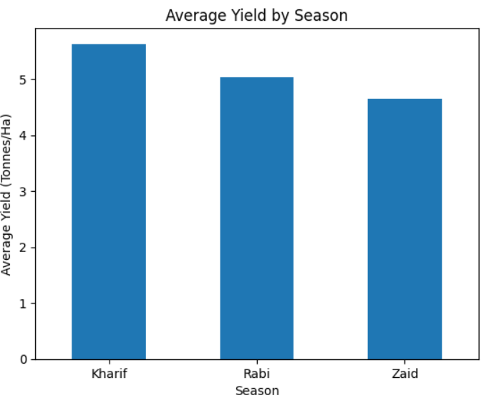
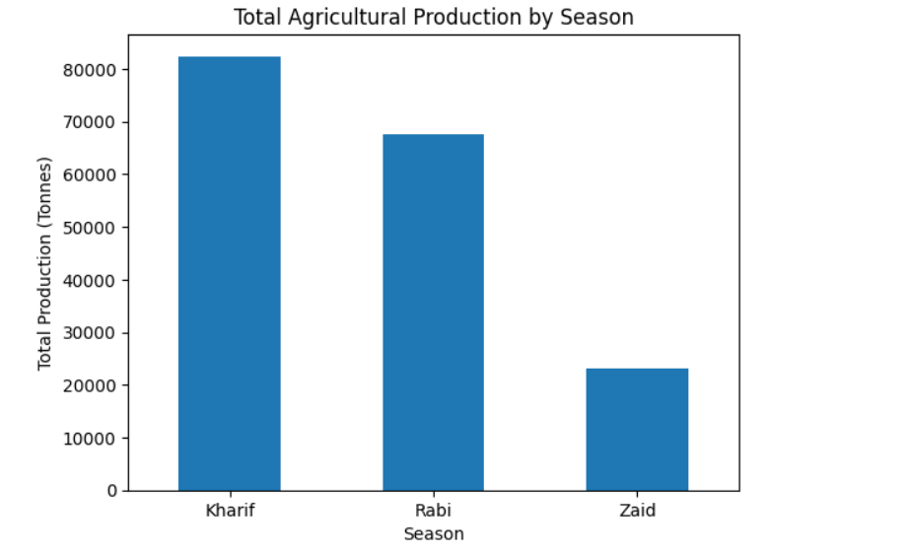
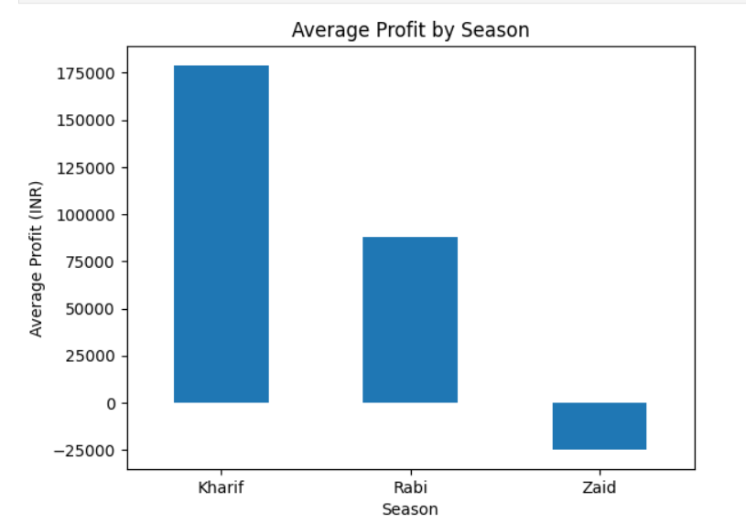
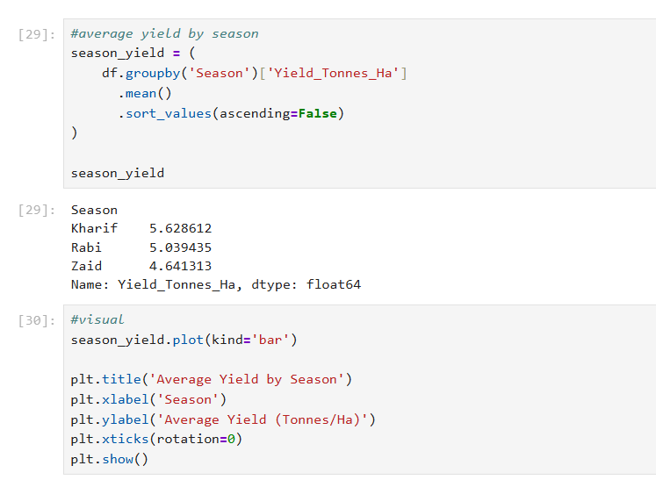
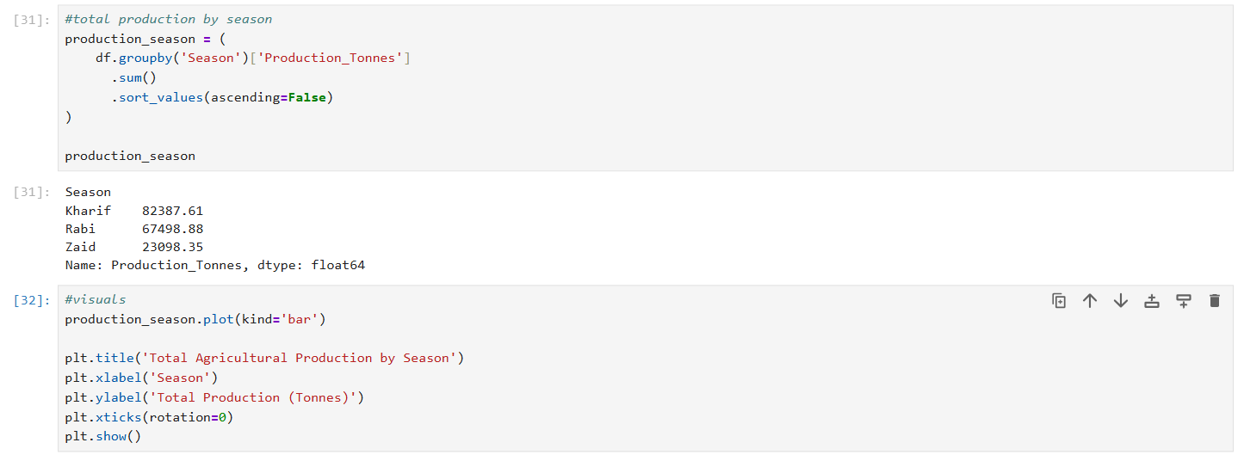
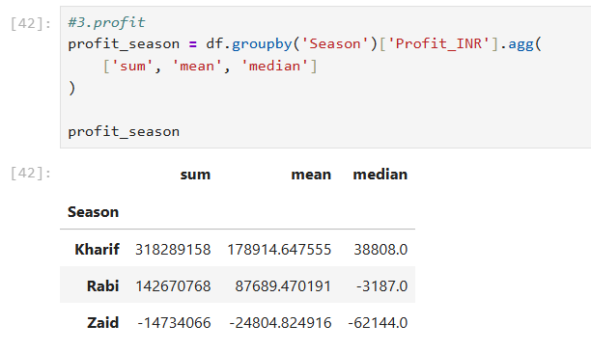
Seasonal Performance
Kharif leads in yield, production and profitability, while Zaid records the weakest overall performance.

Slide 8
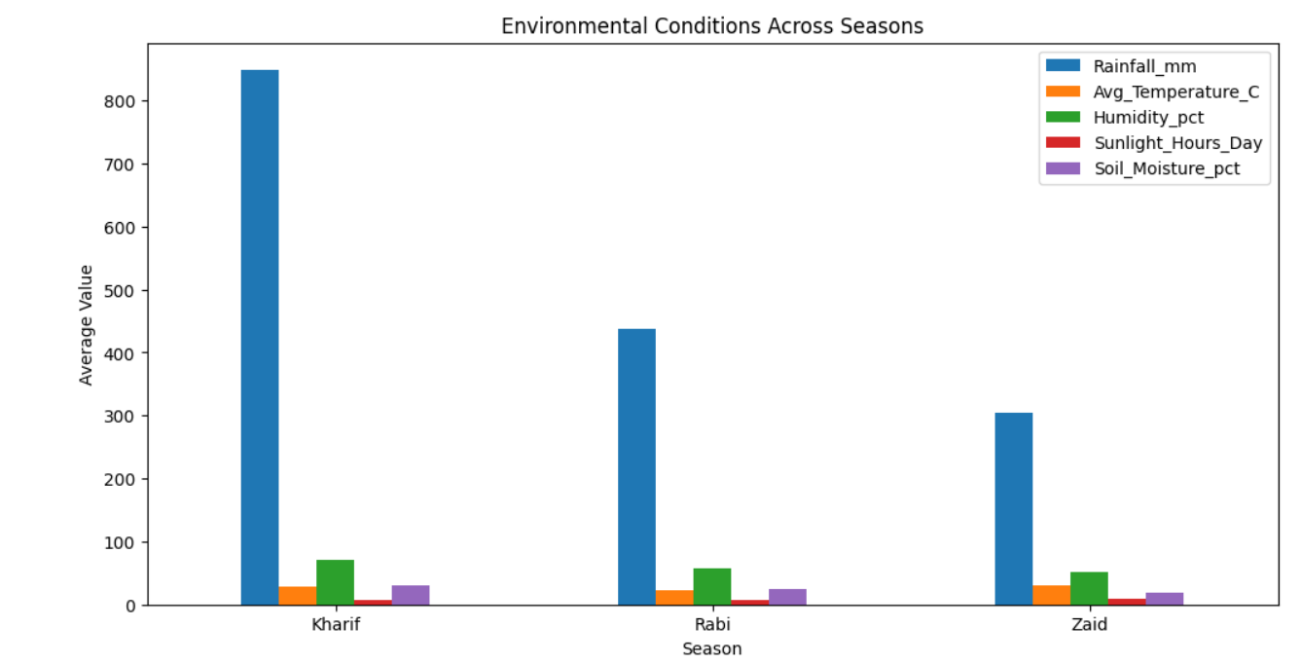
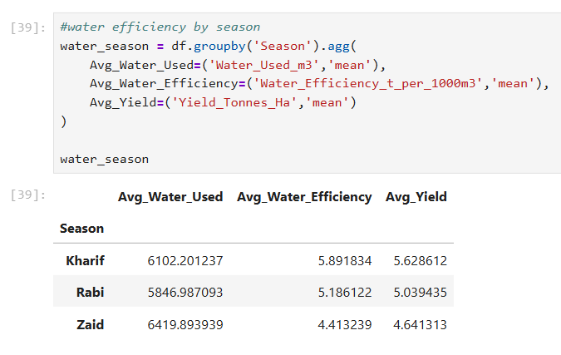
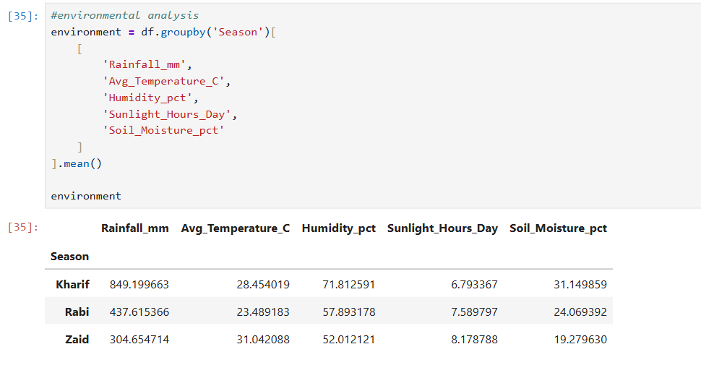
RESULTS
Environment & Resource Efficiency
Kharif combines higher rainfall and soil moisture with stronger yield and water efficiency, whereas Zaid uses more water but achieves lower water efficiency.

Slide 9
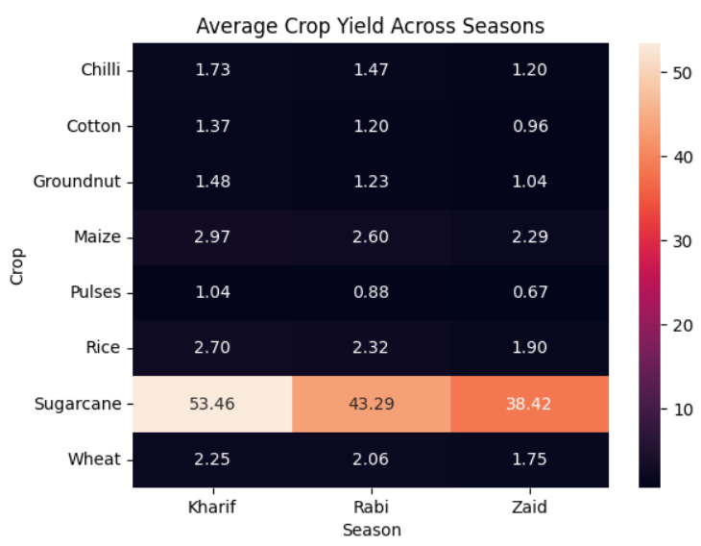
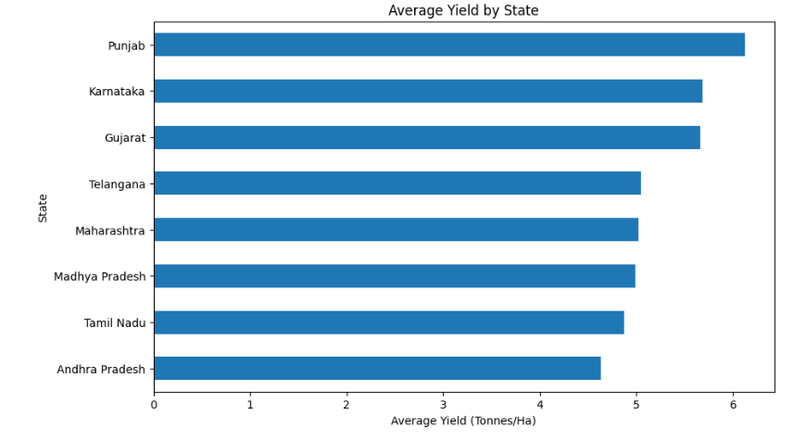
RESULTS
Crop & Regional Analysis
Agricultural performance varies significantly by crop, season and region, indicating the importance of crop-season and regional suitability.

Slide 10
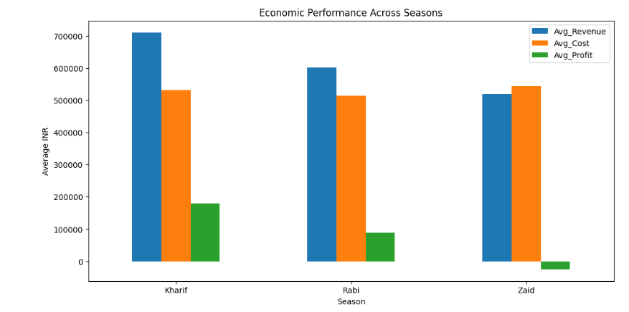
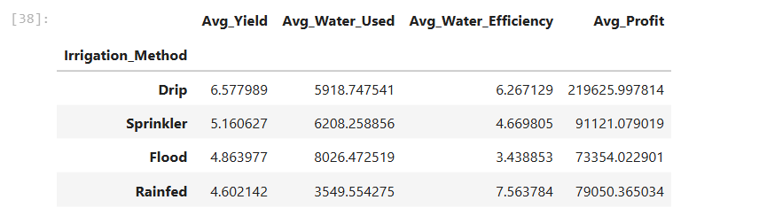
RESULTS
Economic & Irrigation Analysis
Highest yield = 6.58
Highest average profit = ₹219,626
Drip irrigation provides the strongest combination of yield and profitability, while Zaid shows an aggregate economic loss.

Slide 11
Future scope
This study can be extended by integrating advanced technologies and additional data sources to support more accurate and real-time agricultural decision-making
🌦️
Real-Time Weather Data
│
▼
📡 ──────→ 📊 Future Scope ←────── 🤖
IoT & Agriculture Machine
Sensors Analytics Learning
│
▼
🗺️
GIS & Regional Analysis
│
▼
📱
Farmer Decision Support
🌦️ Real-Time Weather Integration
Include real-time weather data to improve seasonal forecasting and agricultural planning.
📡 IoT and Sensor Data
Use soil, moisture and water sensors for continuous monitoring of farm conditions.
🤖 Machine Learning Models
Develop predictive models for crop yield, profitability and agricultural risk.
🗺️ GIS-Based Regional Analysis
Use geographical data to identify region-specific crop and seasonal performance patterns.
📱 Farmer Decision Support System
Develop a dashboard or application to provide data-driven recommendations for crop and resource planning.

Slide 12
GitHub Link
ayush7518/seasonal-agricultural-performance-analysis

Slide 13
Thank you
.
.

